Slide 1
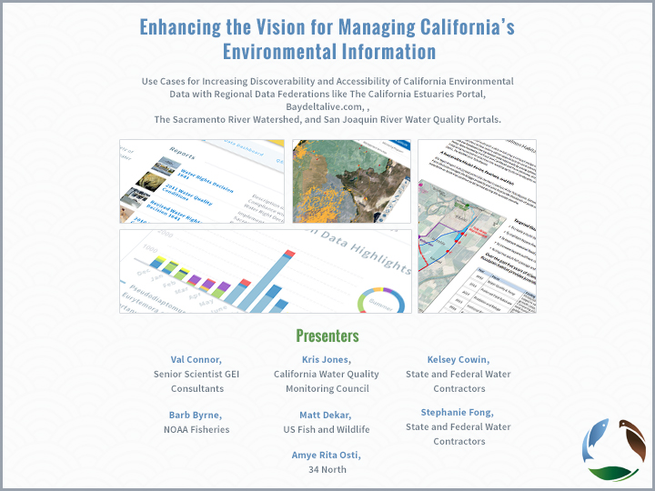

Slide 2
Outline of Presentation/Inline with Data Vision Paper
Data Vision:
Data integration
Web services
Use case development bringing data together: Cache, DOSS, DCT
Technology Vision:
Develop funding and resources for releasing OpenNRM Core as a open-source project for the community.
Invest in open data compilations.
Investment in data provenance.
Other:
Development of sustaining business model and (MOU)
BDL Agency Workgroup

Slide 3
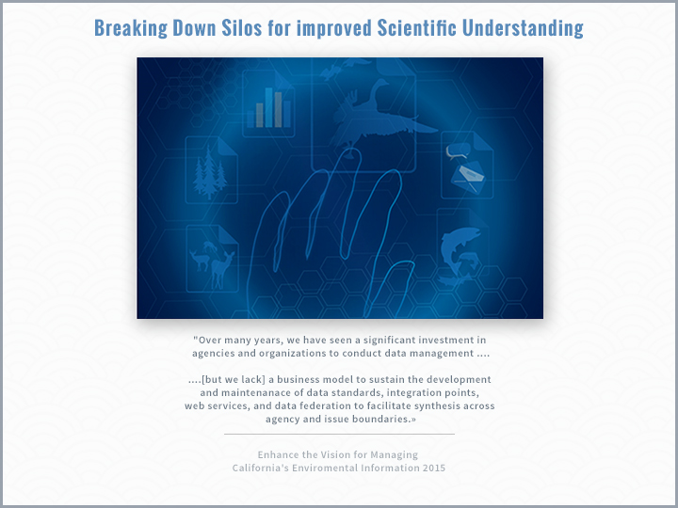

Slide 4
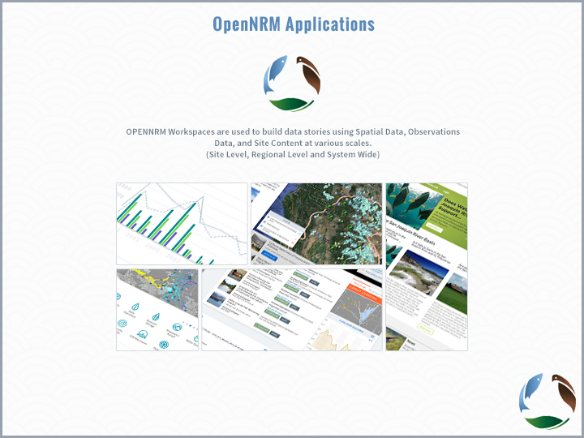

Slide 5
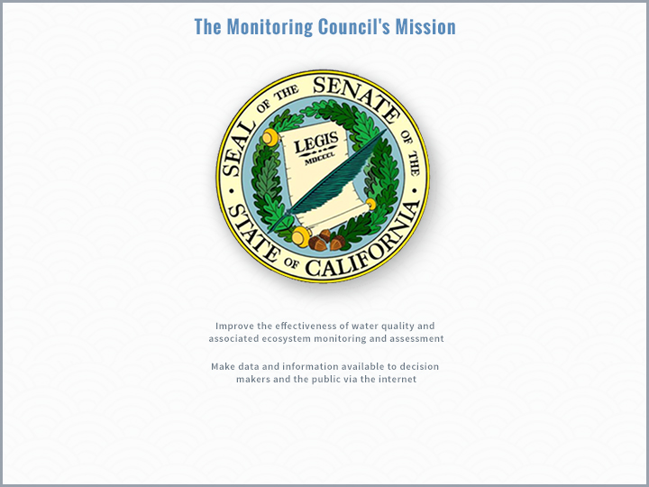

Slide 6
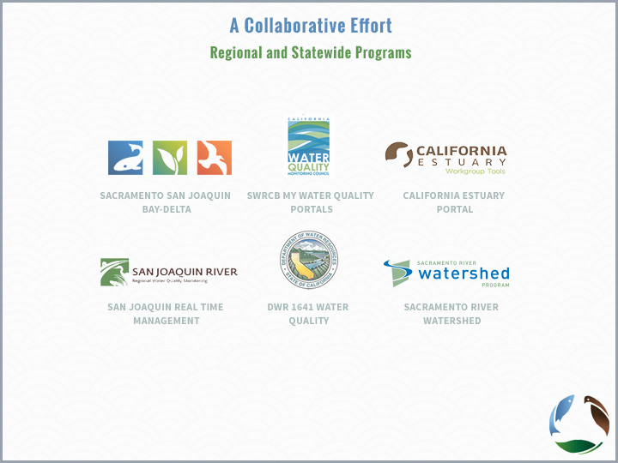

Slide 7
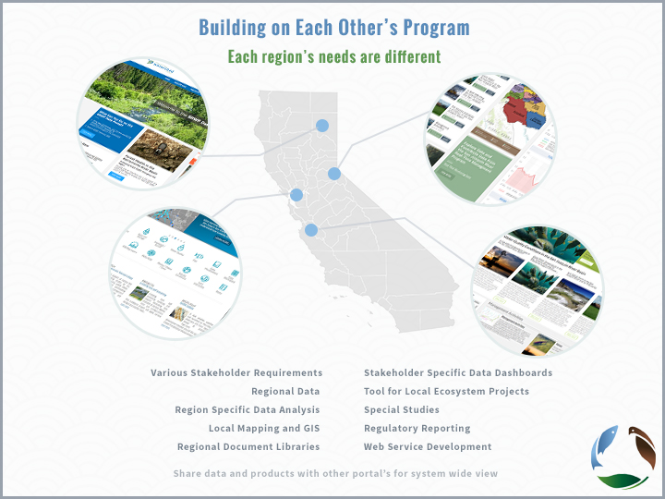

Slide 8
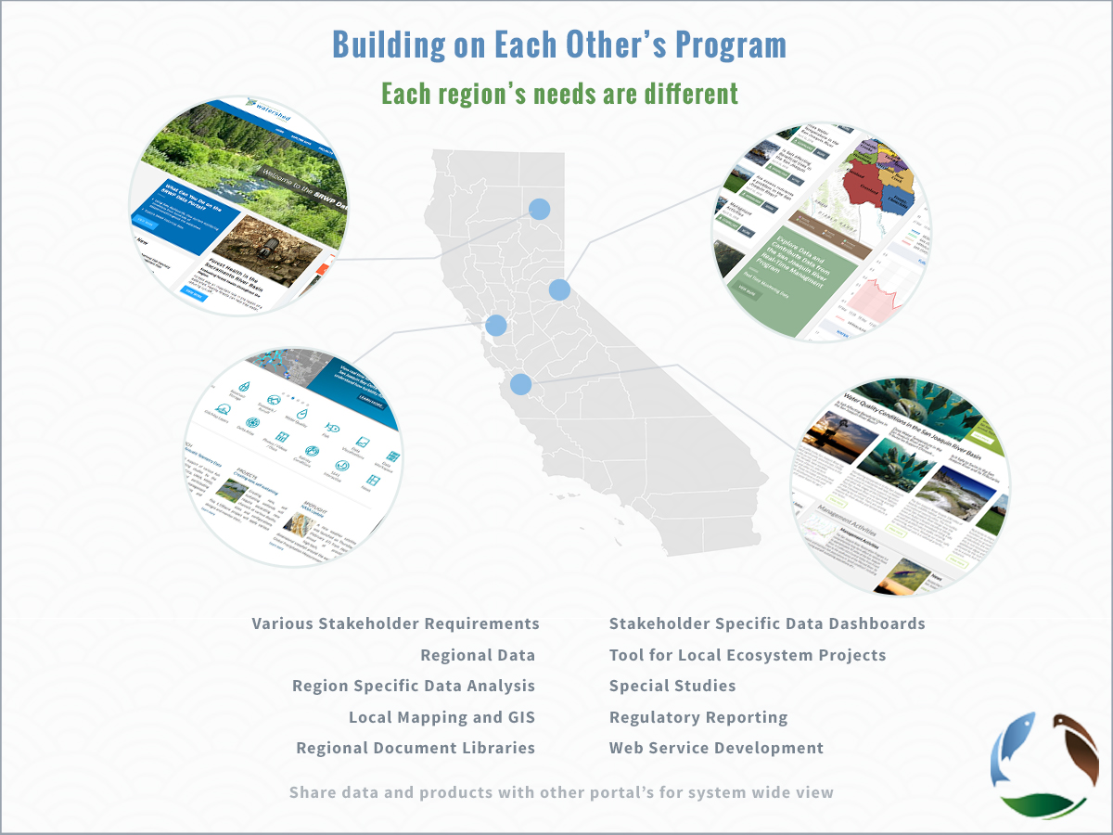

Slide 9
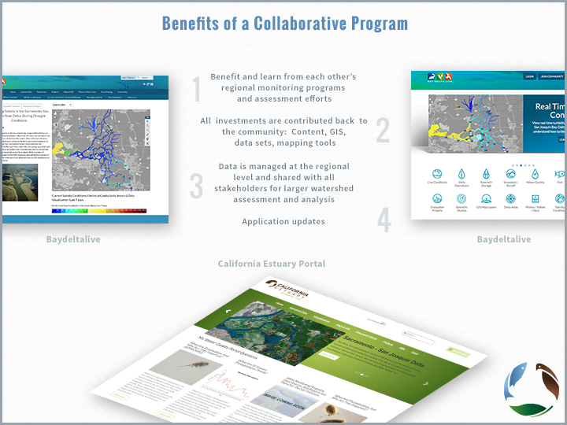

Slide 10
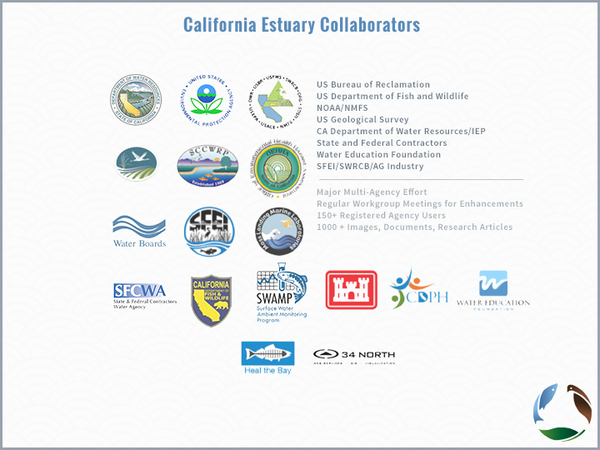

Slide 11
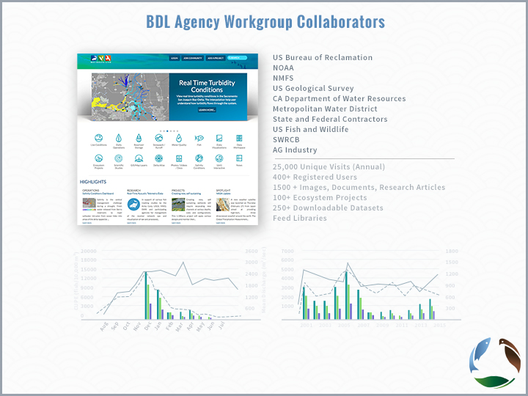

Slide 12
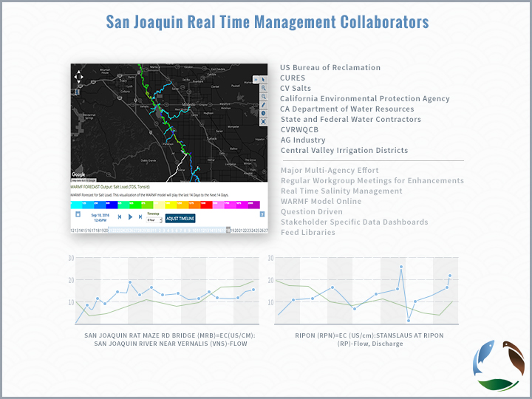

Slide 13
SRWP Collaborators

Slide 14
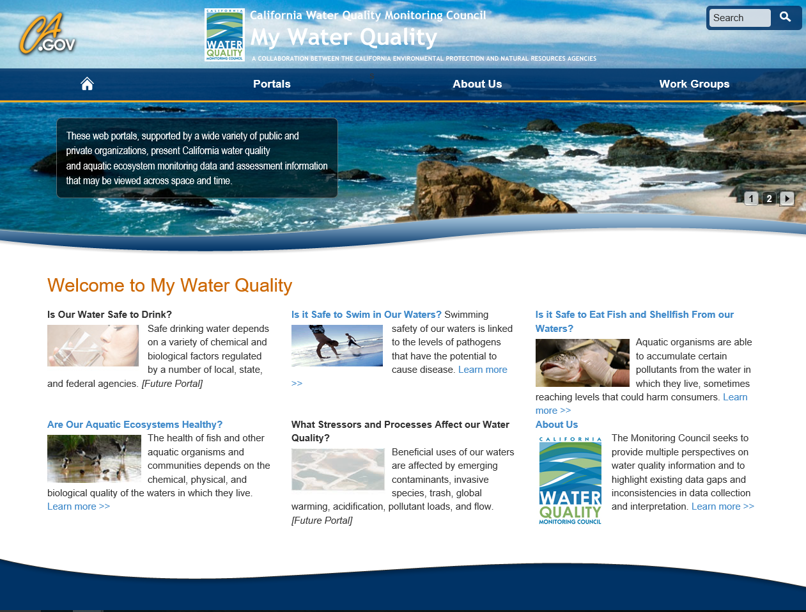
Notes:
As most of you already know, the Monitoring Council has created a number of theme specific portals that seek to make publically published data available to decision makers—focusing on topics such as….. (see slide)
For the purpose of today’s presentation, we’ll focus on those efforts relevant to the Bay Delta—specifically those toolsets developed by 34North for the California Estuaries Portal and Bay Delta Live.

Slide 15
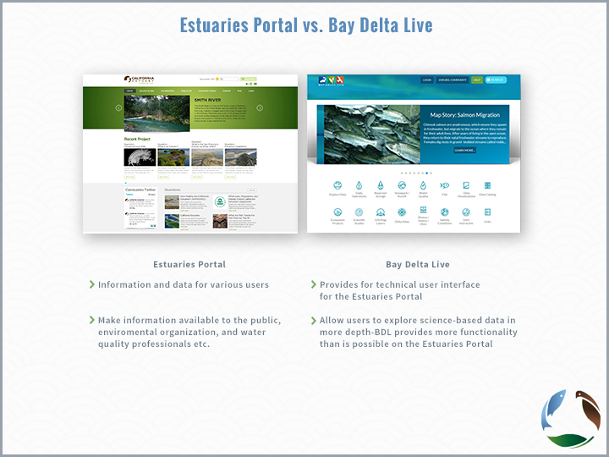

Slide 16
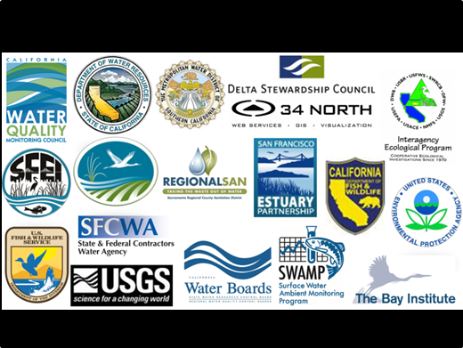
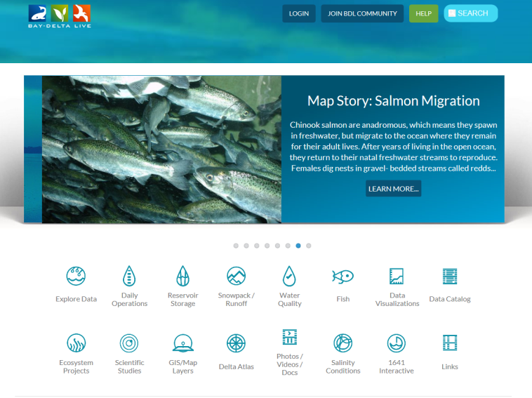
Estuaries Portal vs. Bay Delta Live?
Estuaries Portal
Information and data for various users
Make information available to the public, environmental organizations, and water quality professionals etc.
Bay Delta Live
Provides for technical user interface for the Estuaries Portal
Allows users to explore science-based data in more depth—BDL provides more functionality than is possible on the Estuaries Portal
Notes:
So what is the relationship between the Estuary Workgroup, the Estuaries Portal and Bay Delta Live?
These two efforts began independently, but have considerable overlap
Deciding to reduce redundancies and build on existing efforts, these two groups recently decided to merge efforts back in spring 2016.
How this takes shape is still to be determined; however, the Agency Working Collaboration Team has agreed to bring the Bay Delta Live effort into the existing California Estuary Monitoring Workgroup. (Slide with Umbrella, slide 6).
Moving forward, these portals will still exist separately….
The Estuaries Portal will focus on making information and data available for various users.
While BDL will really focus on publically available science-based data, real-time visual/analytical tools accessible through hand-held devices (e.g.: iPhone) and the building block for multi-agency interaction and policy decisions based on best available science.
For both efforts, the data is maintained by the originating source entity.

Slide 17
Val:
Not sure if like the title of umbrella as it
suggests that BDL is a subset of Estuary
Monitoring Group. They are linked to each
other w/differing goals as stated.
Estuary Monitoring Workgroup
Estuaries Portal
Information and data for various users
Make information available to the public, environmental organizations, and water quality professionals etc.
Bay Delta Live
Provides for technical user interface for the Estuaries Portal
Allows users to explore science-based data in more depth—BDL provides more functionality than is possible on the Estuaries Portal

Slide 18
Projects
Project Image Compilation

Slide 19
Projects
Projects:
  200 Projects, geo-located with key data, documents, images, videos and GIS.
  Demonstrate Cache Collaborative Projects, Info Hub and Current Conditions. *Info hub and key aspects of this project are scheduled for release at Delta Science conference 11/15.
  Plans for the future: moving from project tracking to implementation.
  BDL/CEMW repository for images, reports, documents, GIS.
  Show how to search, access, add

Slide 20
Explore Data
Explore Data Compilation

Slide 21
Explore Data
  Creating the baseline, effort toward transparency
  Review Current Datasets: Discuss data integration, interoperability, techniques, transformation and portability
  Reporting back to agencies and data owners for improved data quality
  Demo exploring and graphing key datasets
  Data federation: querying aggregated data (status and goals).
  Linking: BDL: SRWP, Caestuaries and SJR Real Time Management portals.
  The future

Slide 22
Data and Data Products
Data Products, Data Stories, Dashboard Compilation

Slide 23
Projects
There are currently more than 300 + projects available between CEMW and BDL. Users can:
Add images, videos, maps, datasets, articles.
Invite team members, keep private, make public
Build project dashbaords?

Slide 24
Projects
Upload GIS and create interactive maps.
Use existing datasets to build saved data views for implementation and monitoring.
Share data with team members

Slide 25
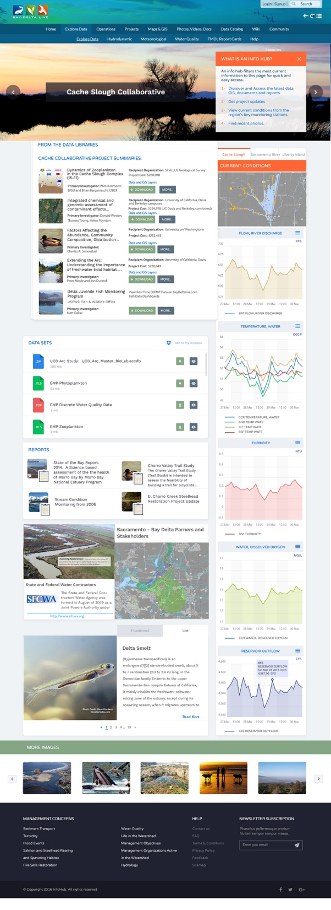

Slide 27
Data/Data products
Data Dashboards/Data Products: The way forward
  My Water Quality Portals, Report Card and TMDLs
  Demo DOSS/CAMT/ DJFMP, discuss phase 2
  - DCT Salinity/Turbidity (Val)
  By the Numbers (TBD)
  Build your own Dashboard

Slide 28
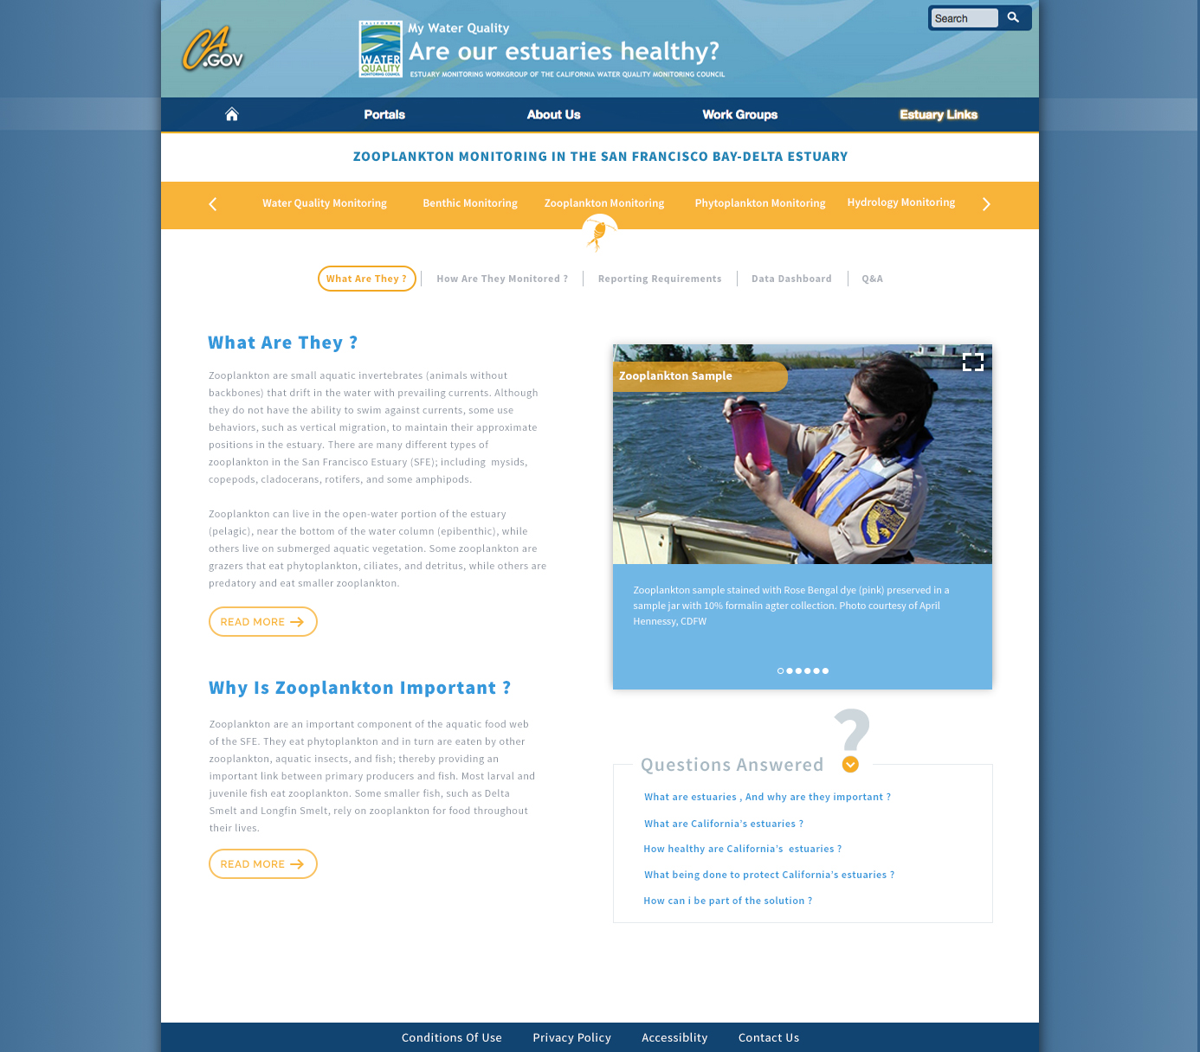
Design 3: Zooplankton What?

Slide 29
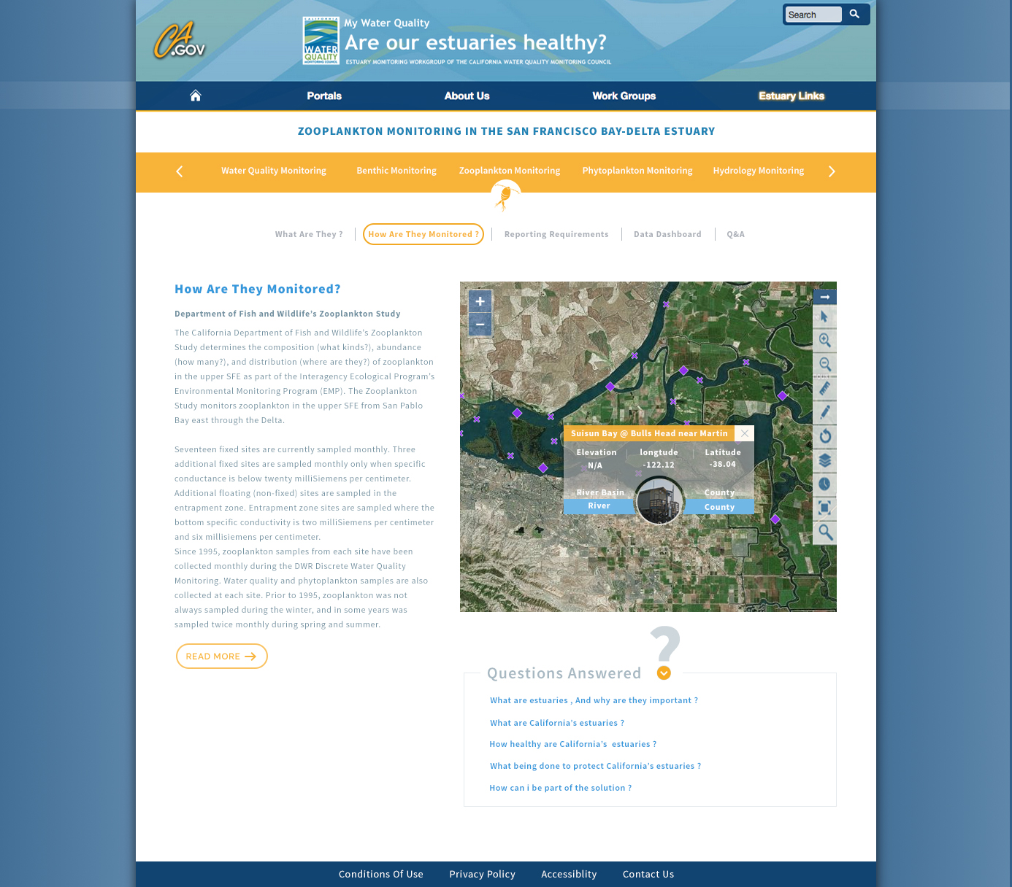
Design 3: Zooplankton How?

Slide 30
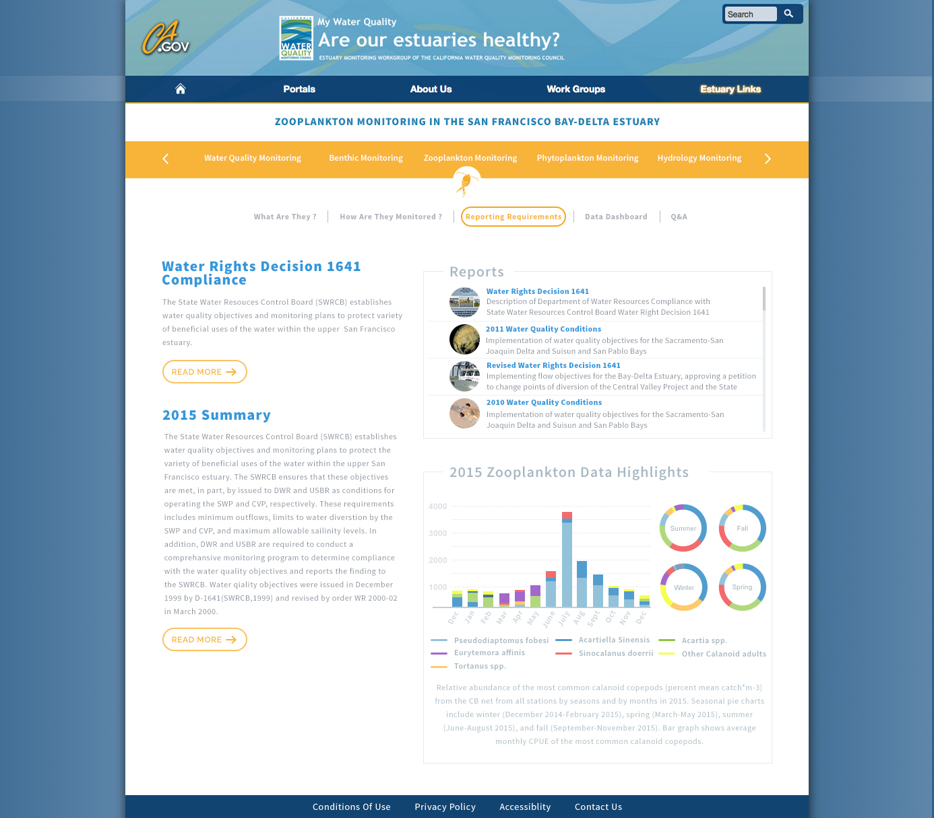
Design 3: Zooplankton Reporting?

Slide 31
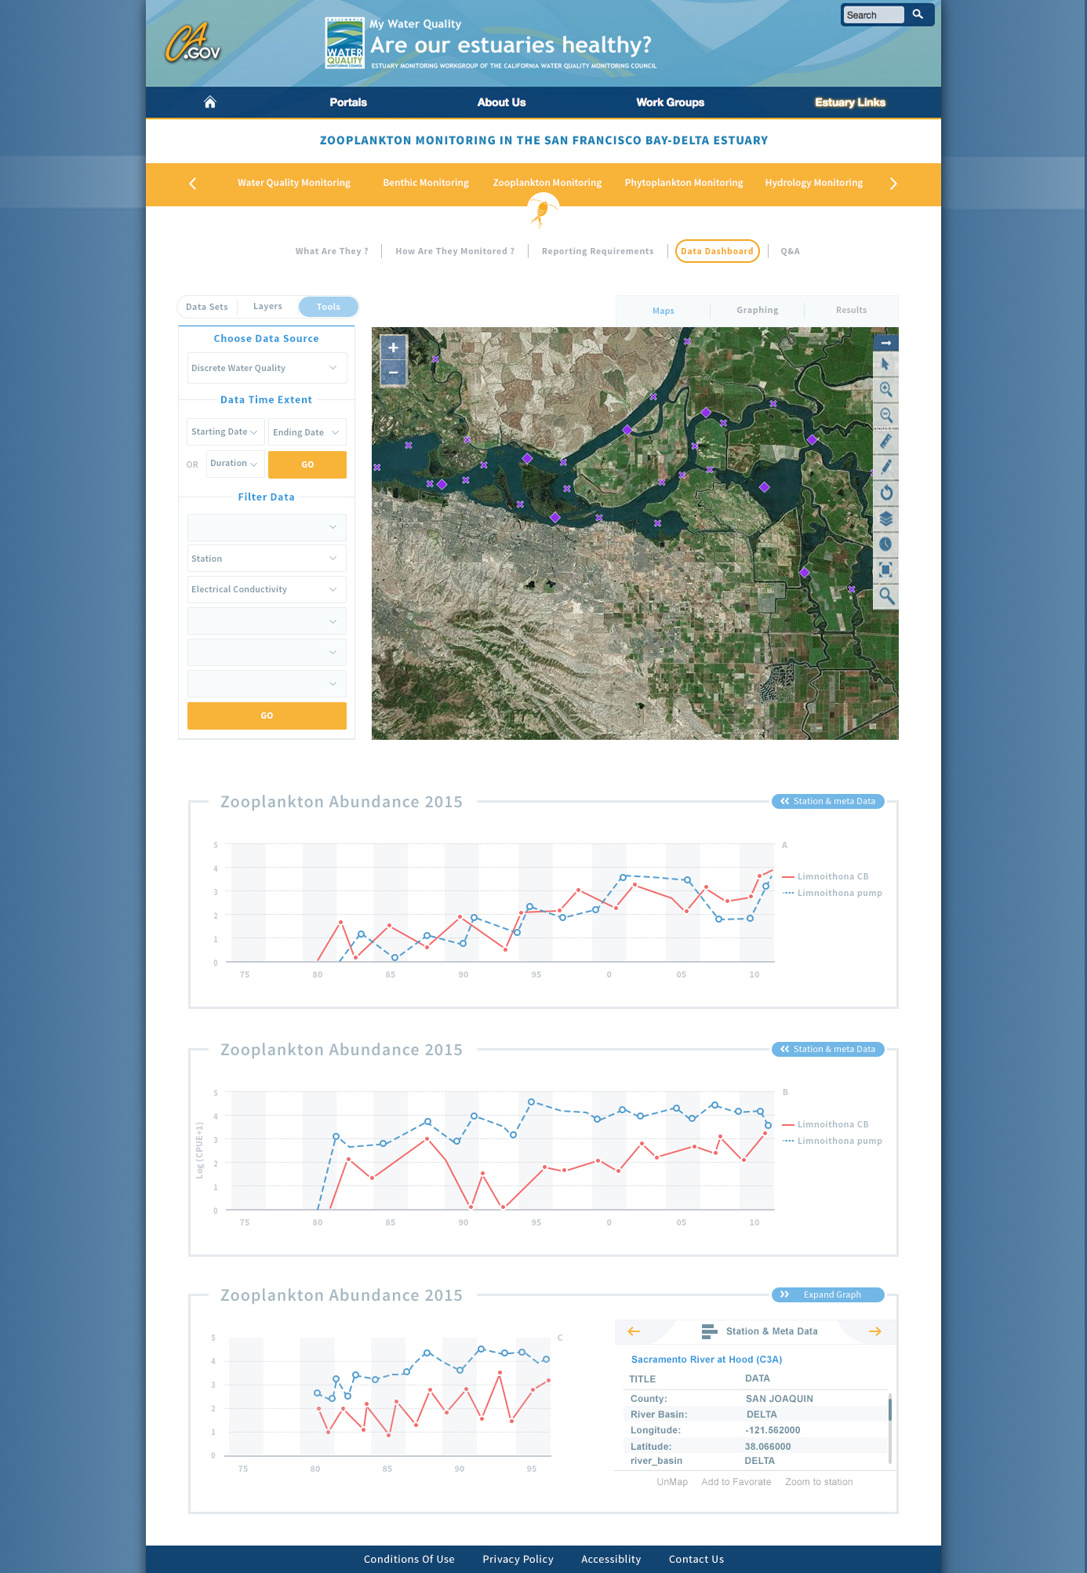
Design 3: Zooplankton Dashboard

Slide 32
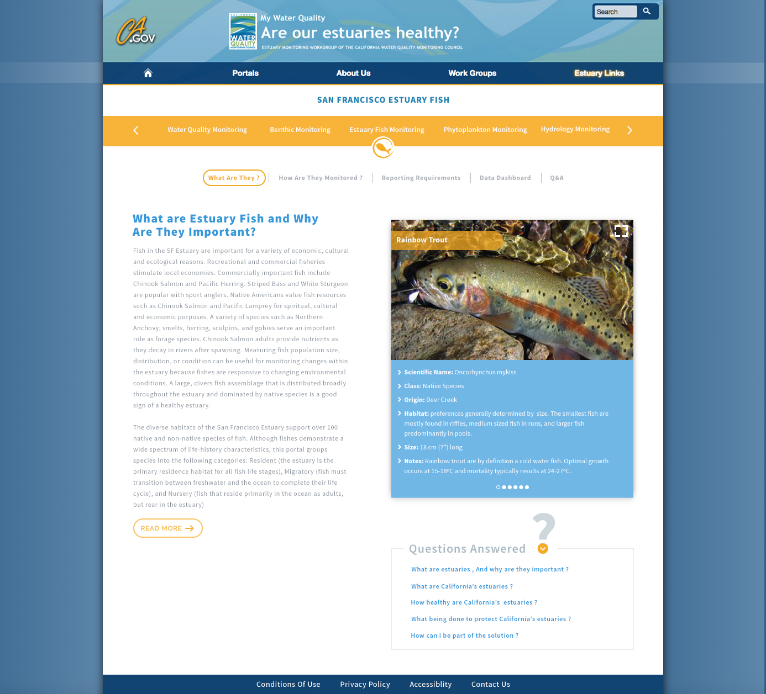

Slide 33
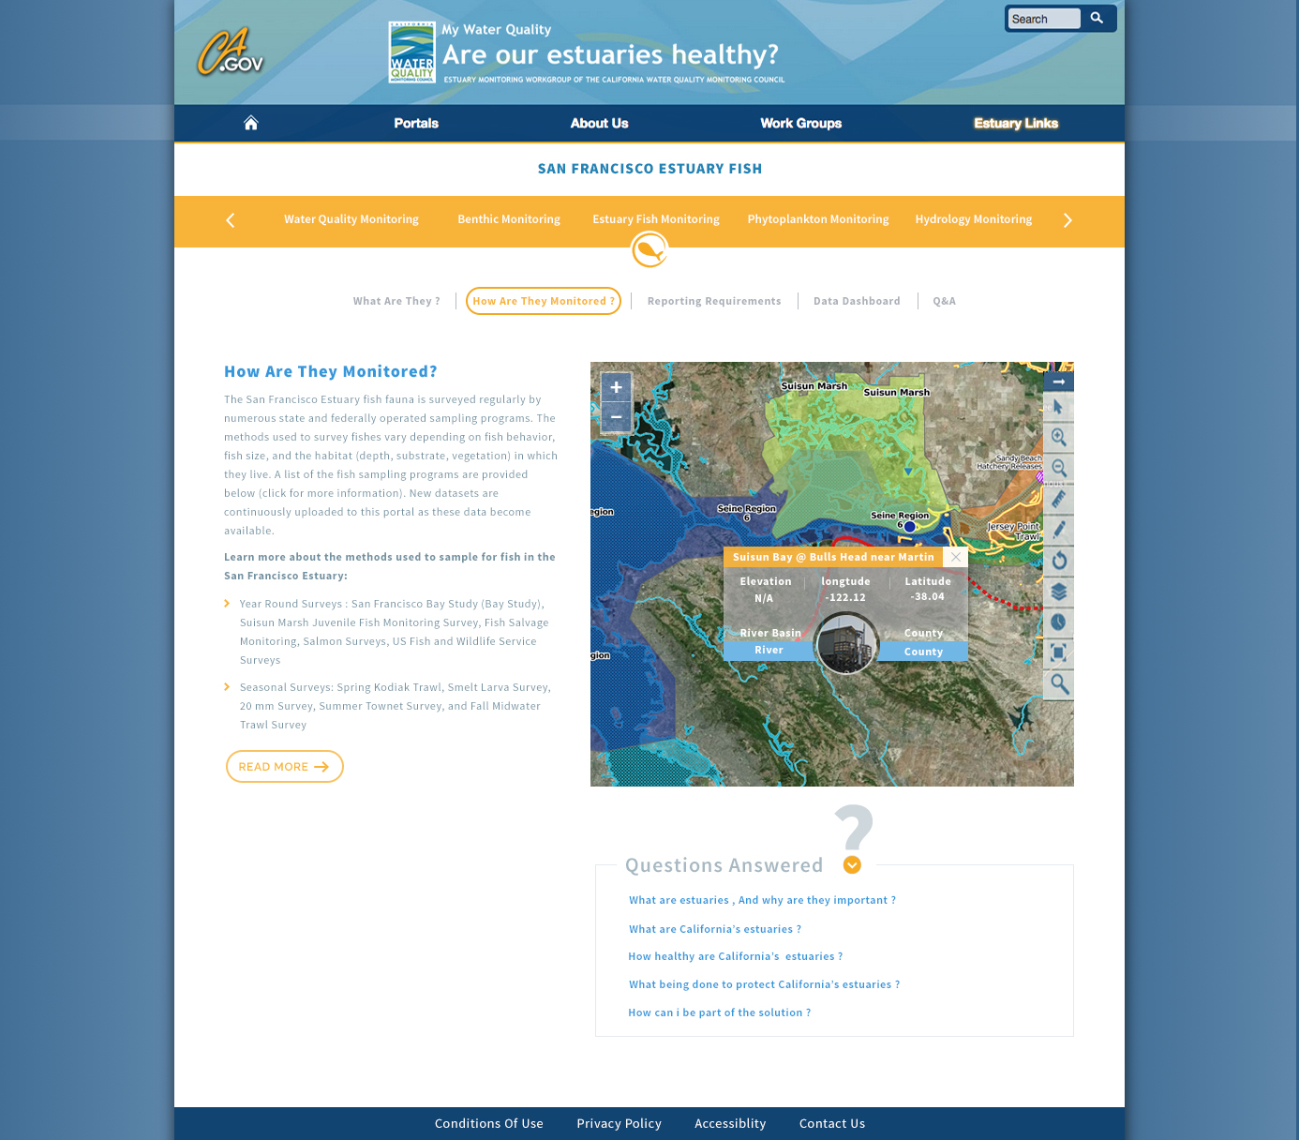

Slide 34
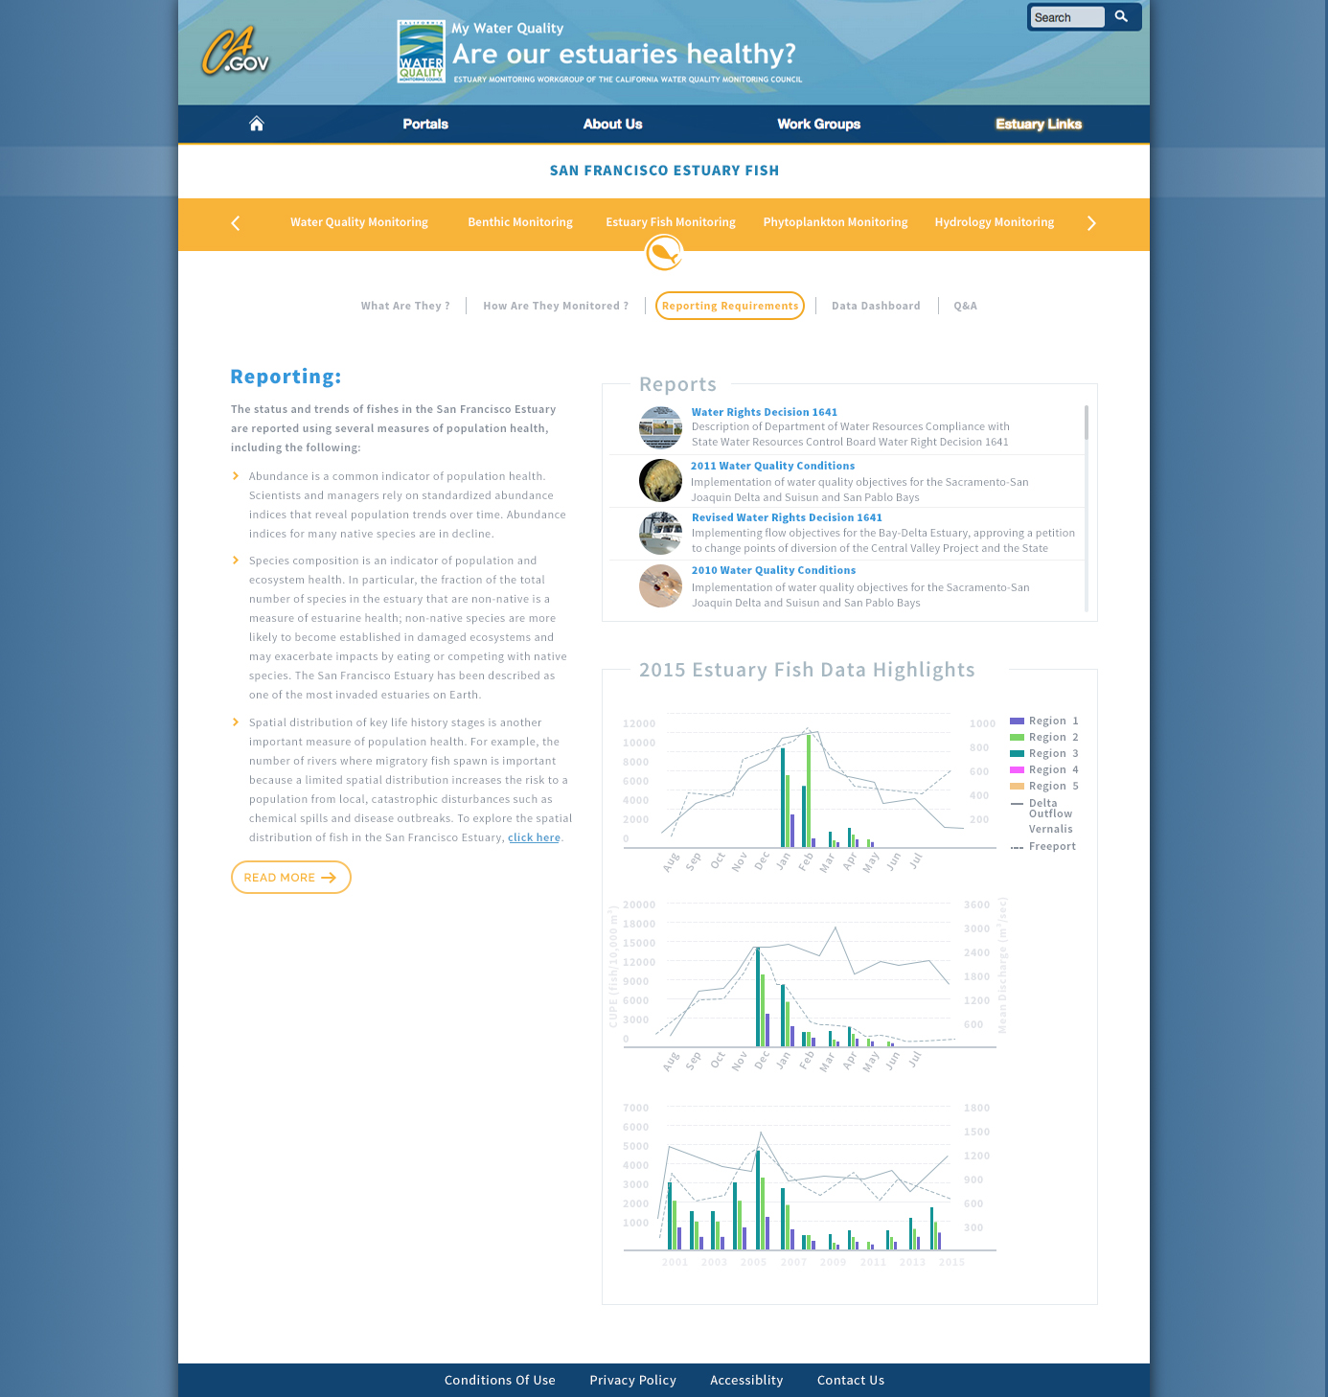

Slide 35
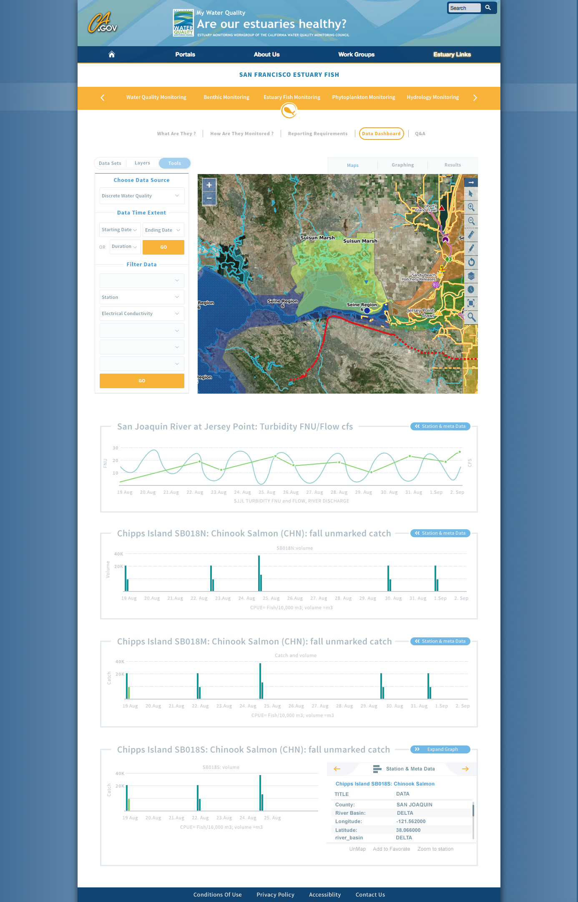

Slide 36
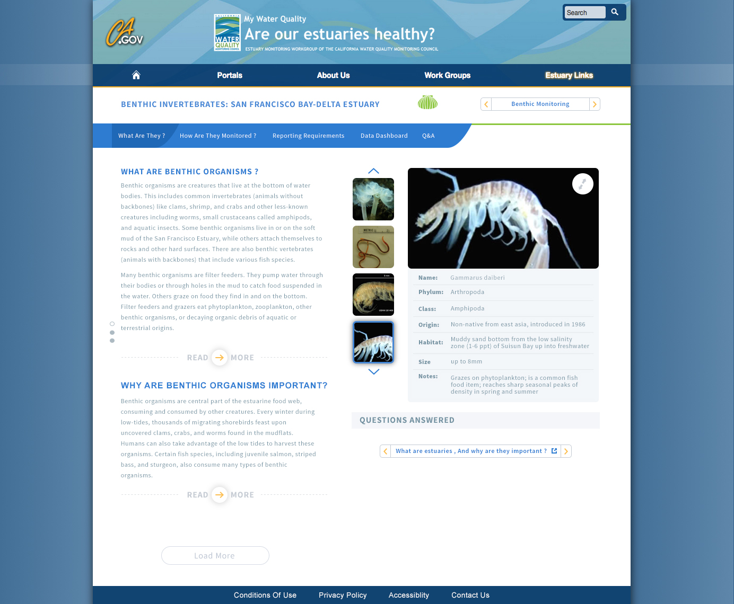
Benthic What are They?
Notes:
Set up a species database for the viewer widget

Slide 37
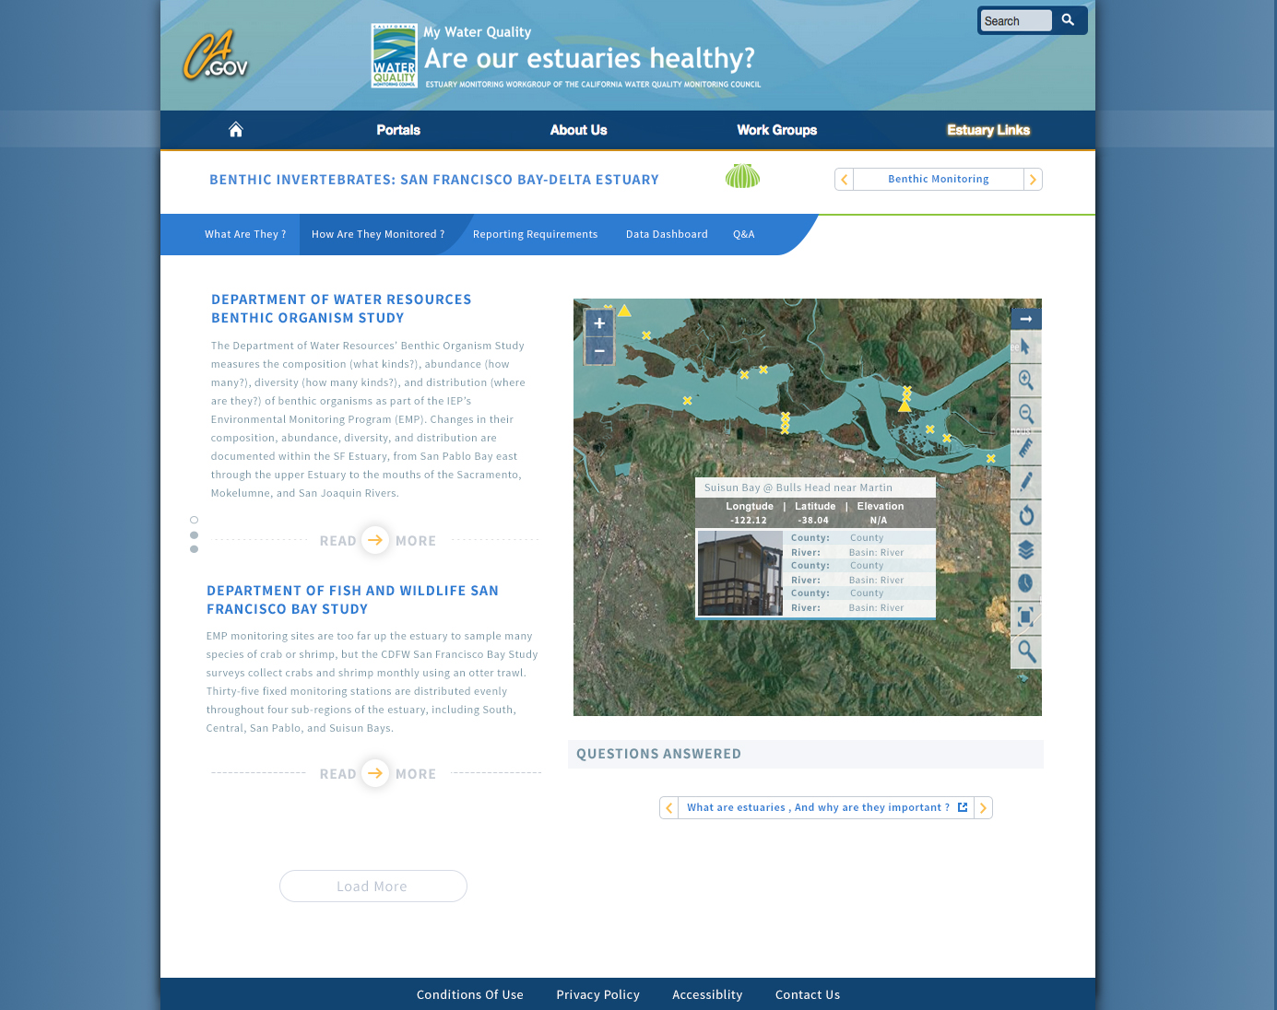
Benthic How are they Monitored?

Slide 38
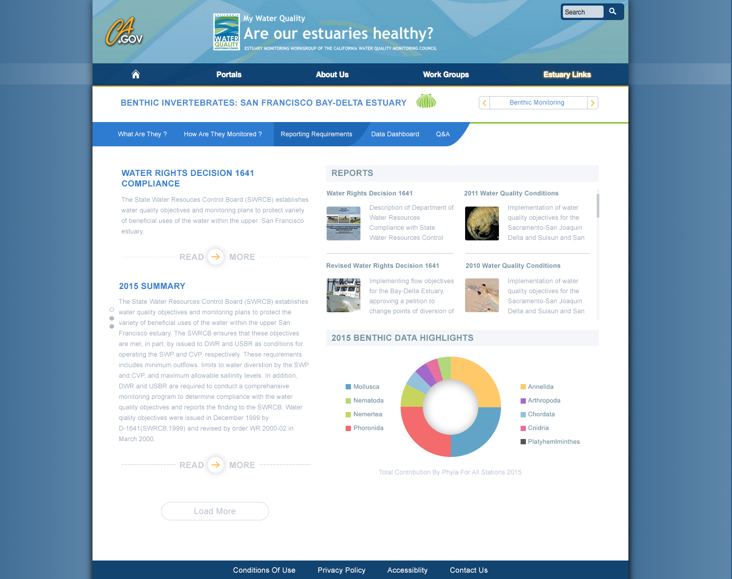
Benthic Reporting
Notes:
Pro-Source Sans

Slide 39
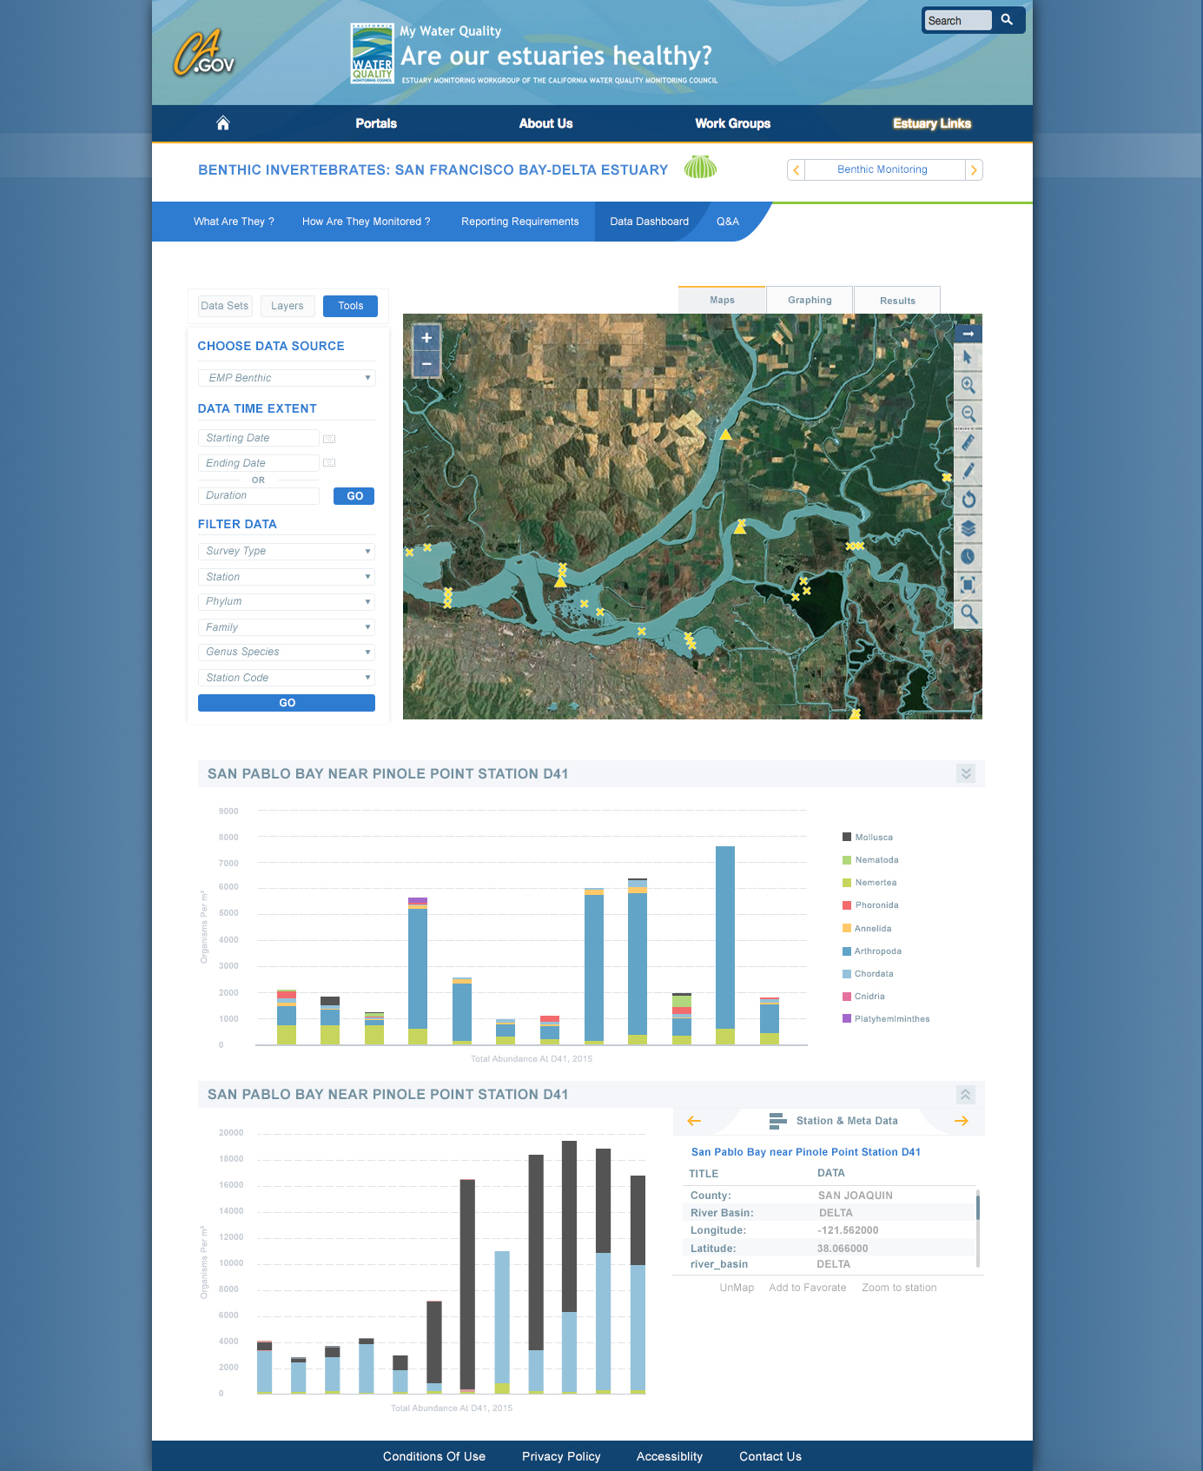
Benthic Data Dashboard

Slide 40

DOSS Dashboard & DJFMP fish monitoring data
Notes:
I will give a brief intro to the objectives of the DOSS Dashboard, demo the dashboard, and hand it back to Amye for presenting the DJFMP data which is used by DOSS as well as many other groups.

Slide 41
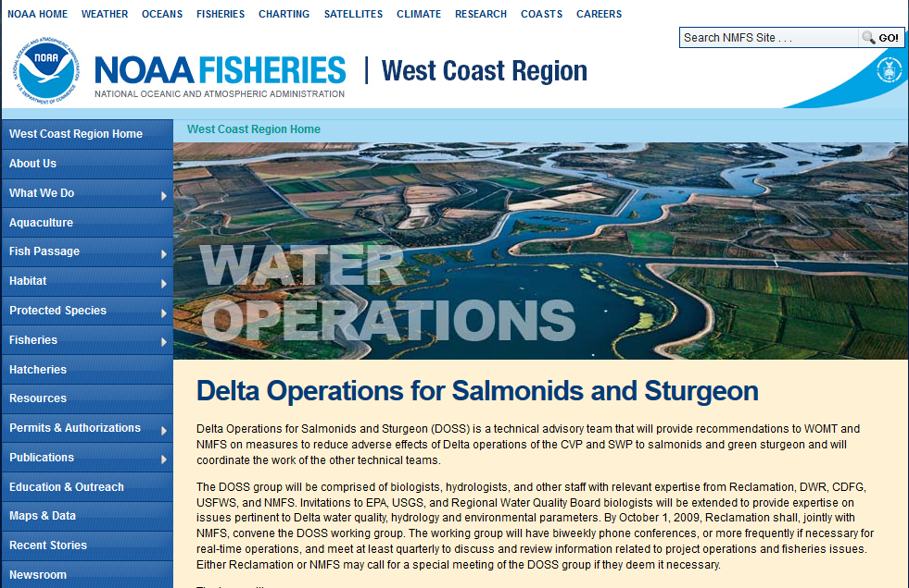

DOSS Technical Team
Created by the 2009 Biological Opinion on Long-term Operations of the CVP and SWP (2009 NMFS BiOp)
Tracks implementation of Delta actions in the Reasonable and Prudent Alternative (RPA)
Member agencies include:
    Reclamation
    FWS
    NMFS
    DWR
    DFW
    SWRCB
    EPA
    USGS
http://www.westcoast.fisheries.noaa.gov/central_valley/water_operations/doss.html
Notes:
DOSS was created by the 2009 NMFS BiOp, and this technical team tracks Delta RPA actions and provides advice as needed. DOSS includes participants from 8 member agencies; I am the DOSS lead for NMFS.

Slide 42
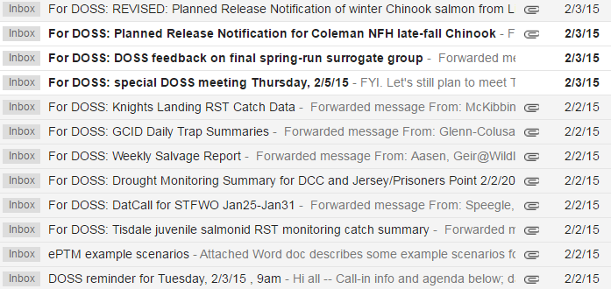
Data distribution to DOSS currently occurs via e-mail
Notes:
Because of the many different sources of data currently reviewed by DOSS, and because many of the monitoring data are prelim data shared by e-mail and not posted online, current data distribution to DOSS is via a batch of e-mails sent on Monday afternoons before the Tuesday DOSS meeting. This is functional, but could be more efficient.

Slide 43
Data distribution to DOSS currently occurs via e-mail
CENTRALIZE with Bay Delta Live’s DOSS Dashboard!
Notes:
Bay Delta Live provides a centralized location for all data streams and provides key summary measures relevant for 2009 NMFS BiOp implementation.
This centralization and summarization is also of value for groups other than DOSS.

Slide 44
DOSS reports out to multiple groups
 | Monday | Tuesday | Wednesday | Thursday | Friday
Morning |  | DOSS |  | DAT | DCT
Afternoon |  | WOMT
DOSS: Delta Operations for Salmonids and Sturgeon
-- agency technical staff
WOMT: Water Operations Management Team
-- agency management and some agency technical staff
DAT: Data Assessment Team
-- stakeholders
DCT: Delta Conditions Team
-- stakeholders
Notes:
This table shows the typical schedule of Delta ops-related meetings during Oct – June, which is the period of highest activity for DOSS (is when ESA-listed species under NMFS jurisdiction are likely to be present in the Delta).
I provide a verbal or written DOSS report to the three meetings that happen after DOSS, listing any alerts or action responses triggered and presenting the highlights of the various DOSS data streams. Detailed data is available to participants only if they receive the data via e-mail, or if they go seek it out, e.g. on CDEC. SO, having a common data hub that allows interested parties to see all the data reviewed by DOSS is very useful and improves efficiency for agency staff and stakeholders.
Before we demo the BDL website, I want to provide a specific example of a data-intensive RPA action for which the DOSS Dashboard provides streamlining.

Slide 45
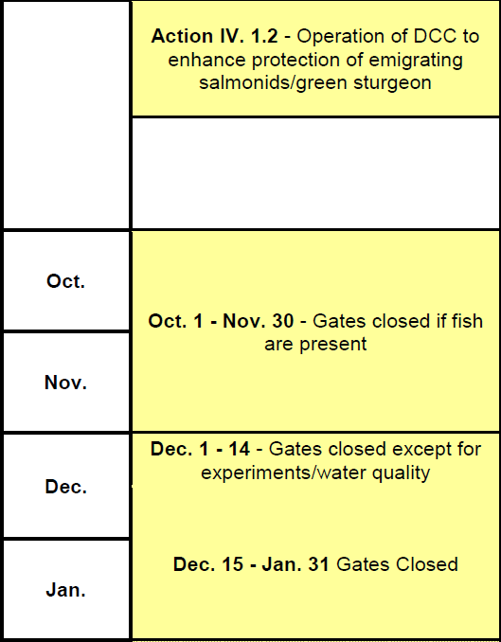
Action IV.1.2: Delta Cross Channel operations
Notes:
Action IV.1.2 of the RPA provides guidelines for Delta Cross Channel oeprations. Before Dec 15th, the DCC gates may be open unless certain conditions are met. DOSS tracks those conditions, which consist of a set of “alerts” and also a set of triggers that may require DCC closure.

Slide 46
Action IV.1.2: Delta Cross Channel operations
ALERTS
Mill Creek flow (absolute value and % change)
Deer Creek flow (absolute value and % change)
Wilkins slough flow (absolute value) and water temperature
Notes:
During this fall period, there are various alerts that are considered indicators of potential fish movement and “alert” mangers that DCC operations might be necessary in the near future. The alerts include Deer Creek and Mill Creek flows, as well as Wilkins slough flow and KL temps.

Slide 47
Action IV.1.2: Delta Cross Channel operations
ALERTS
Mill Creek flow (absolute value and % change)
Deer Creek flow (absolute value and % change)
Wilkins slough flow (absolute value) and water temperature
CDEC data (MLM)
CDEC data (DCV)
CDEC data (WLK) and CDFW data (from Knights Landing RST data sheets)
Notes:
Bay Delta Live pulls data from these listed sources and summarizes on the DOSS Dashboard <go to BDL to show>

Slide 48
Action IV.1.2: Delta Cross Channel operations
Knights Landing Catch Index
Sacramento Trawl Catch Index
Sacramento Beach Seine Catch Index
WQ conditions
Notes:
The triggers that may require DCC gate closure rely on fish catch at several key monitoring locations, and on WQ conditions. The catch info comes from KL, the Sac Trawl, and the beach seines. WQ conditions are monitored by the Projects, not by DOSS, and relate to requirements in D-1641.

Slide 49
Action IV.1.2: Delta Cross Channel operations
Knights Landing Catch Index
Sacramento Trawl Catch Index
Sacramento Beach Seine Catch Index
WQ conditions
DJFMP data
Notes:
Note that these two monitoring locations rely on DJFMP data.

Slide 50
Action IV.1.2: Delta Cross Channel operations
Knights Landing Catch Index
Sacramento Trawl Catch Index
Sacramento Beach Seine Catch Index
WQ conditions
CDFW data + calculation
DJFMP data + calculation
DJFMP data + calculation
CDEC data + linkage to D-1641 criteria
Notes:
As for the alerts, Bay Delta Live pulls data from these listed sources and summarizes on the DOSS Dashboard <go to BDL to show>

Slide 51
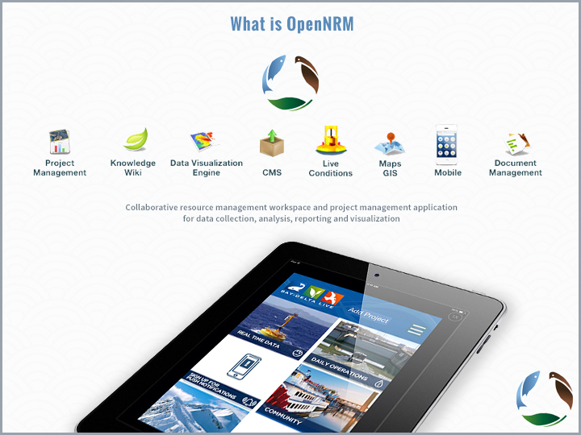

Slide 52
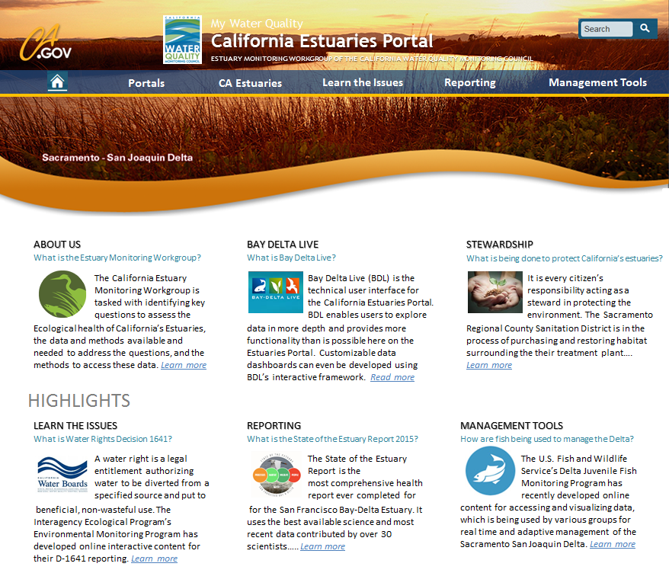
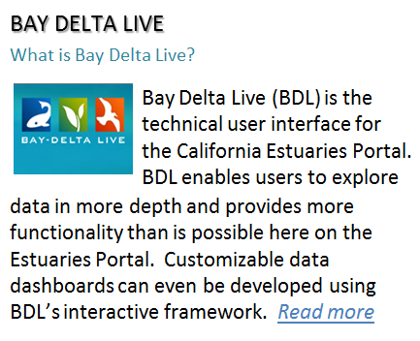
New California Estuaries Portal Design

Slide 53
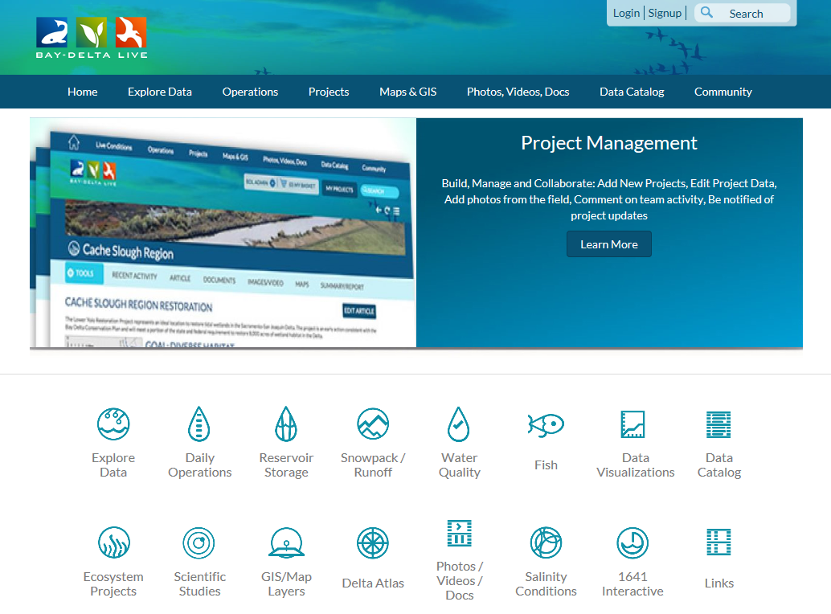
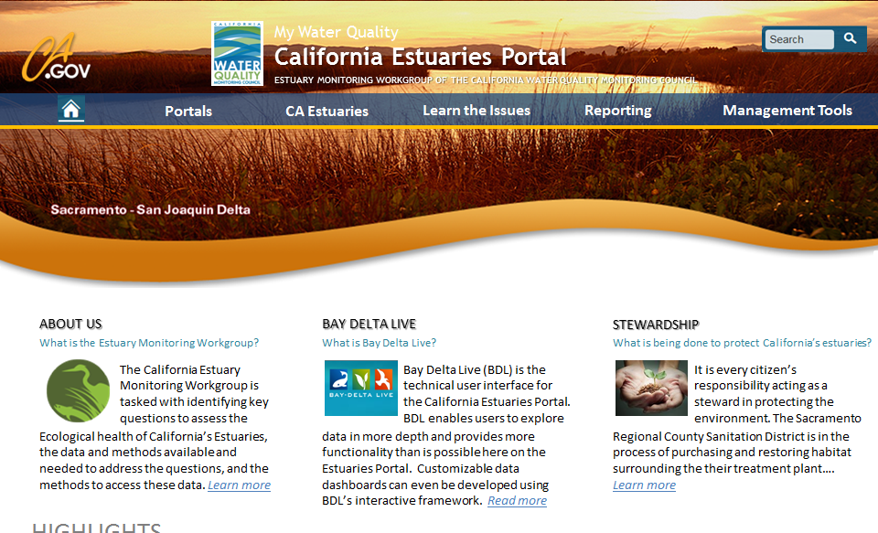

California Estuaries Portal
A product of the California Water Quality Monitoring Council’s Estuary Monitoring Workgroup, the California Estuaries Portal presents information on the health of California’s estuaries, with an initial emphasis on the San Francisco Estuary. While Bay Delta Live (BDL) serves as the technical user interface, the California Estuaries Portal brings data and information together in a single location and in an easy to understand manner for the public, environmental organizations, and water quality professionals. The goal is to make this information as timely and user-friendly as possible.

Slide 54
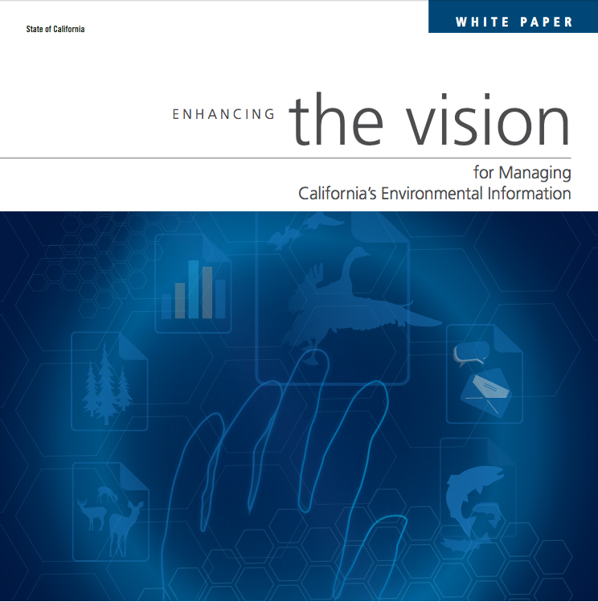
Breaking Down Silos for Improved Scientific Understanding
“Over many years, we have seen a significant investment in agencies and organizations to conduct their data management….
….[but we lack] a business model to sustain the development and maintenance of data standards, integration points, web services, and data federation to facilitate synthesis across agency and issue boundaries.”
Enhancing the Vision for Managing California’s Environmental Information 2015
Notes:
In recent years, we have recognized that to make informed management decisions, we need access to data.
These points were highlighted in the Data Summit White Paper, which emphasized that to enable synthesis across agencies and issue boundaries—a federated data system is key.

Slide 55
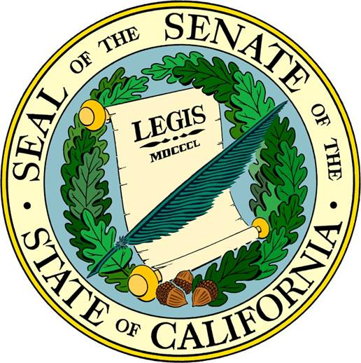
The Monitoring Council’s Mission
Improve the effectiveness of water quality and associated ecosystem monitoring and assessment
Make data and information available to decision makers and the public via the internet
Notes:
The Monitoring Council was formed in response to legislation--SB 1070, back in 2006--to address growing concerns regarding access to Water Quality and Ecosystem Health data.
In addition to data access, there was also an interest to improve coordination and to increase efficiencies among monitoring efforts in California.

