Slide 1
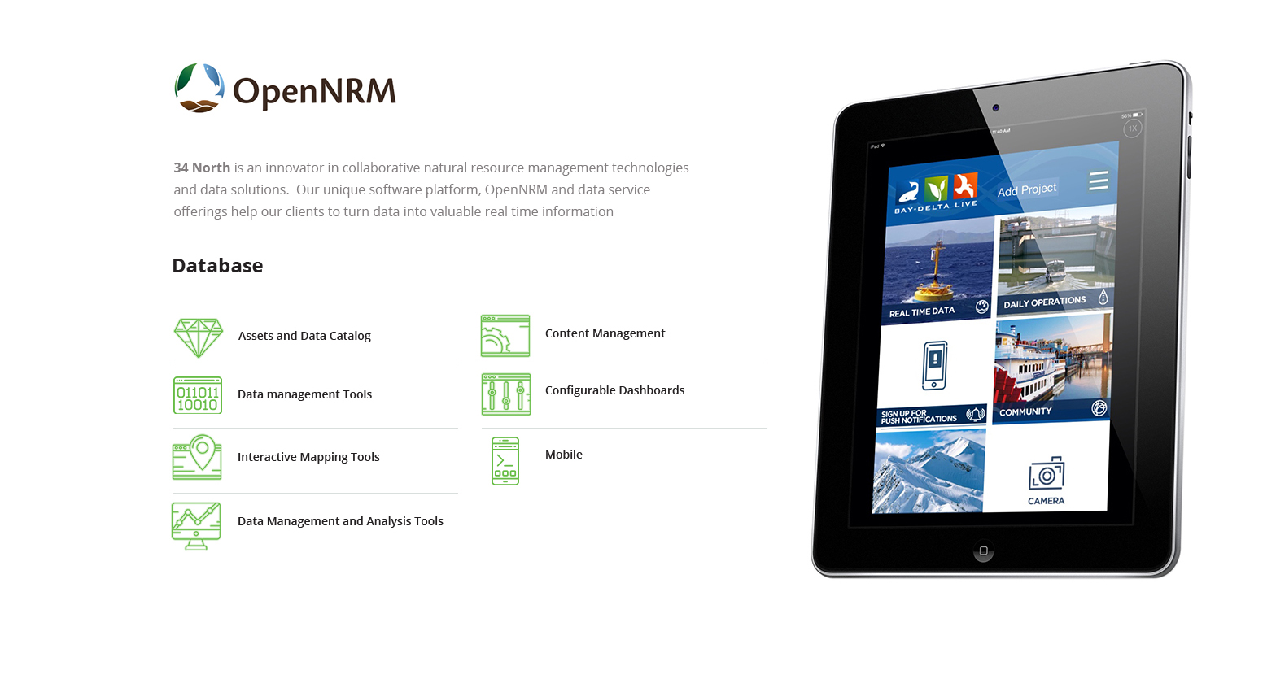

Slide 2
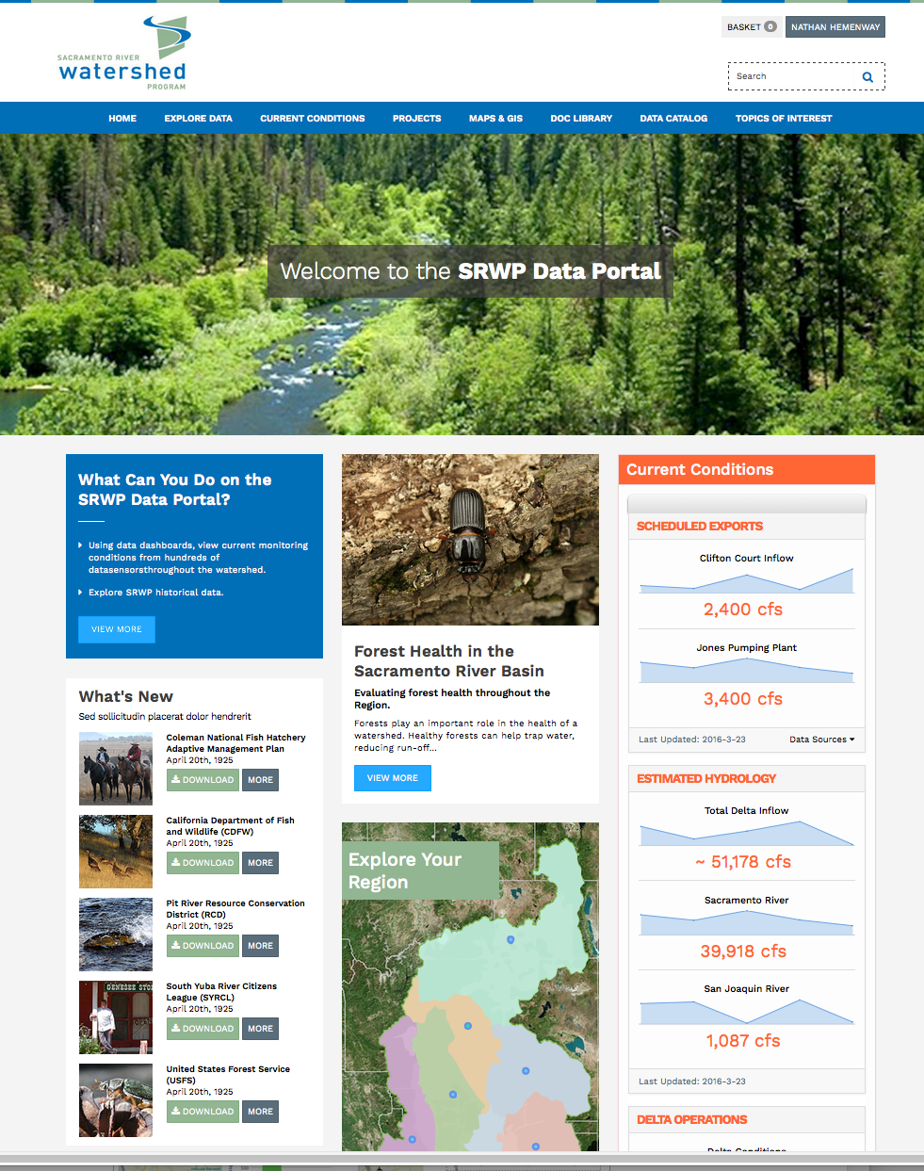

Slide 3
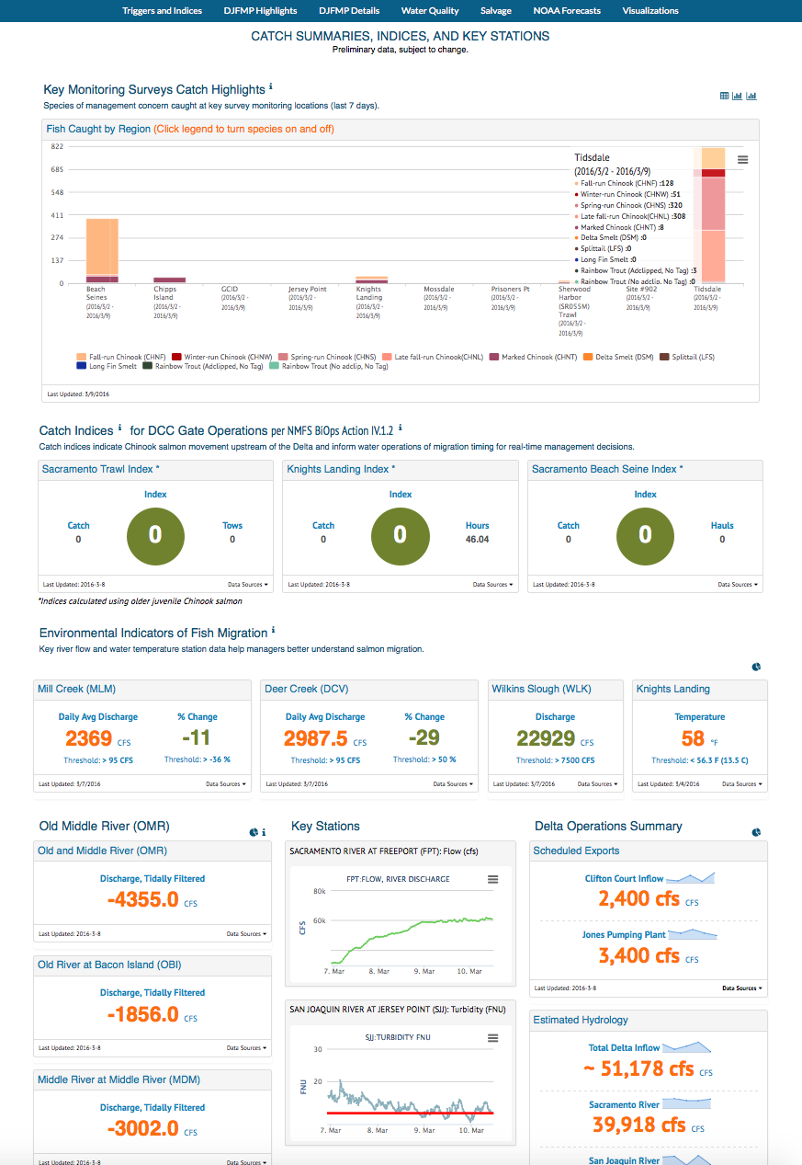
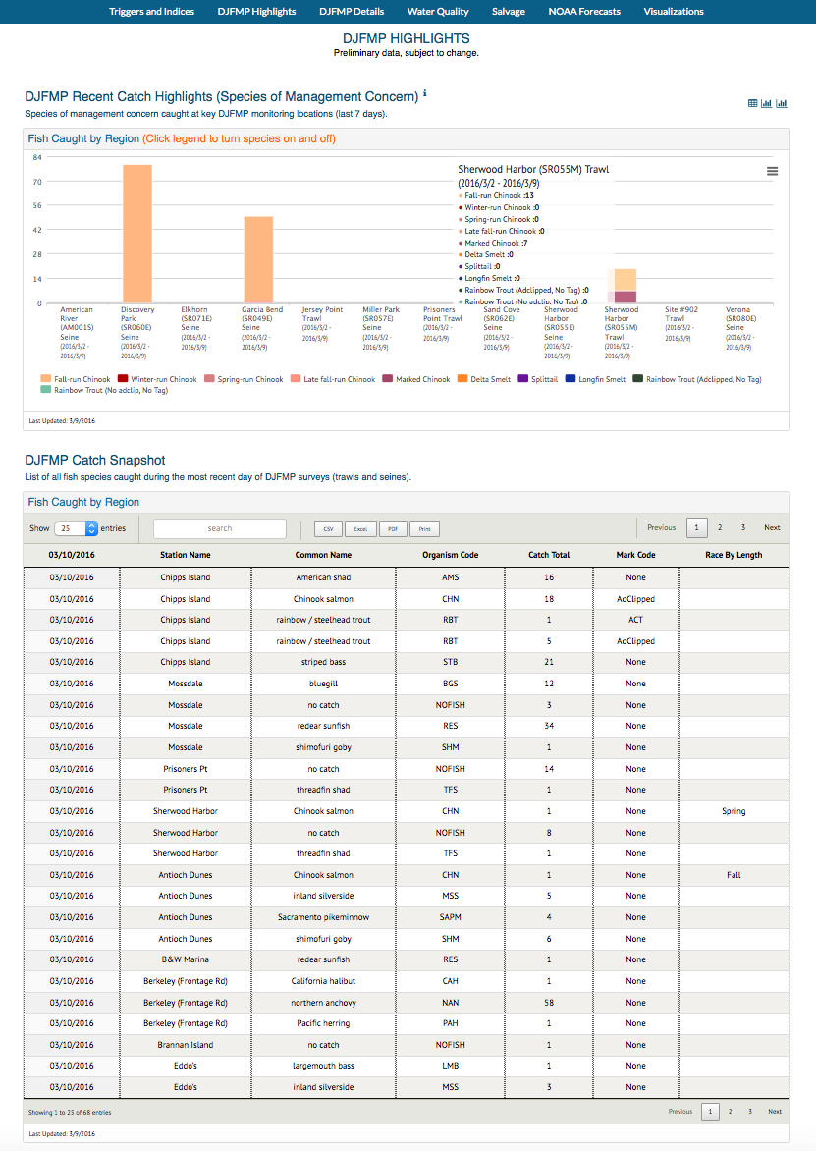
DOSS Data Dashboard

Slide 4
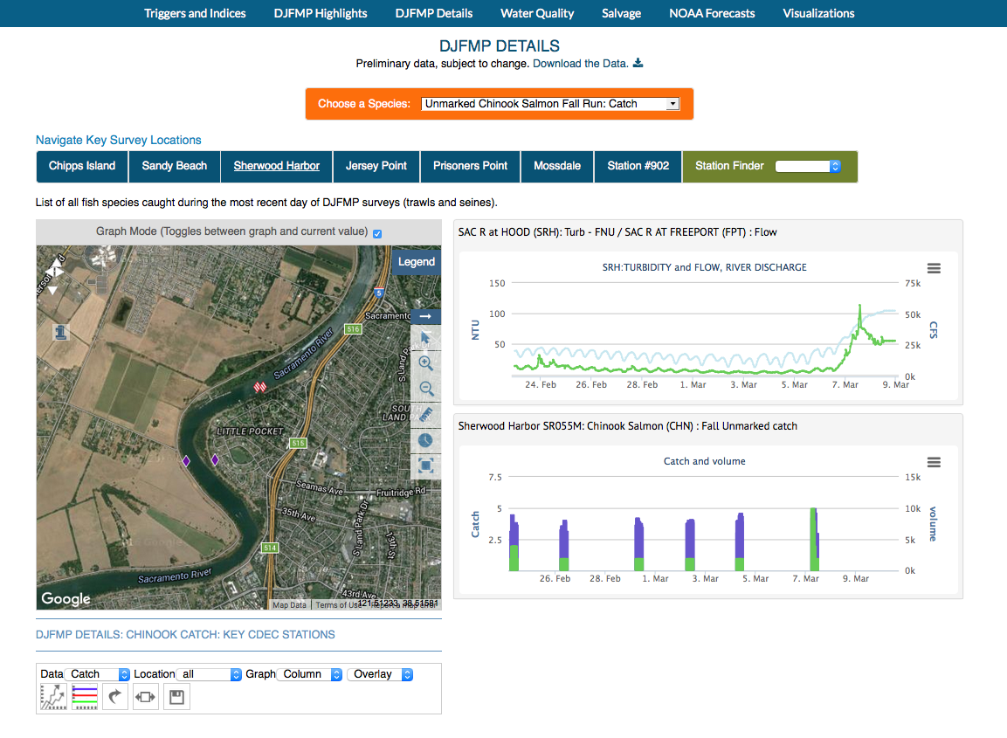
DJFMP Data

Slide 5
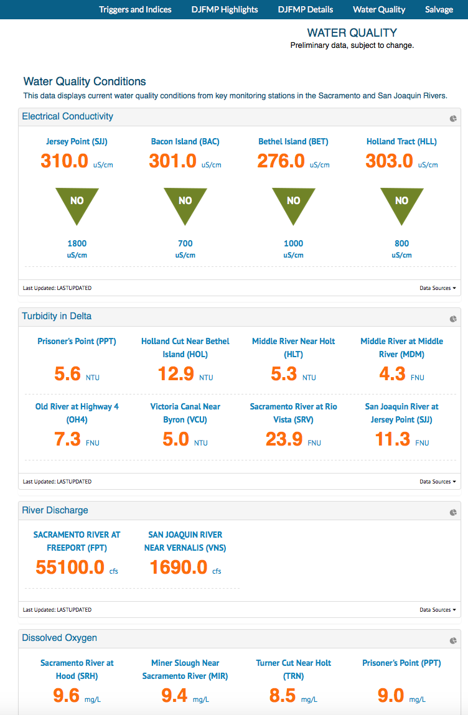
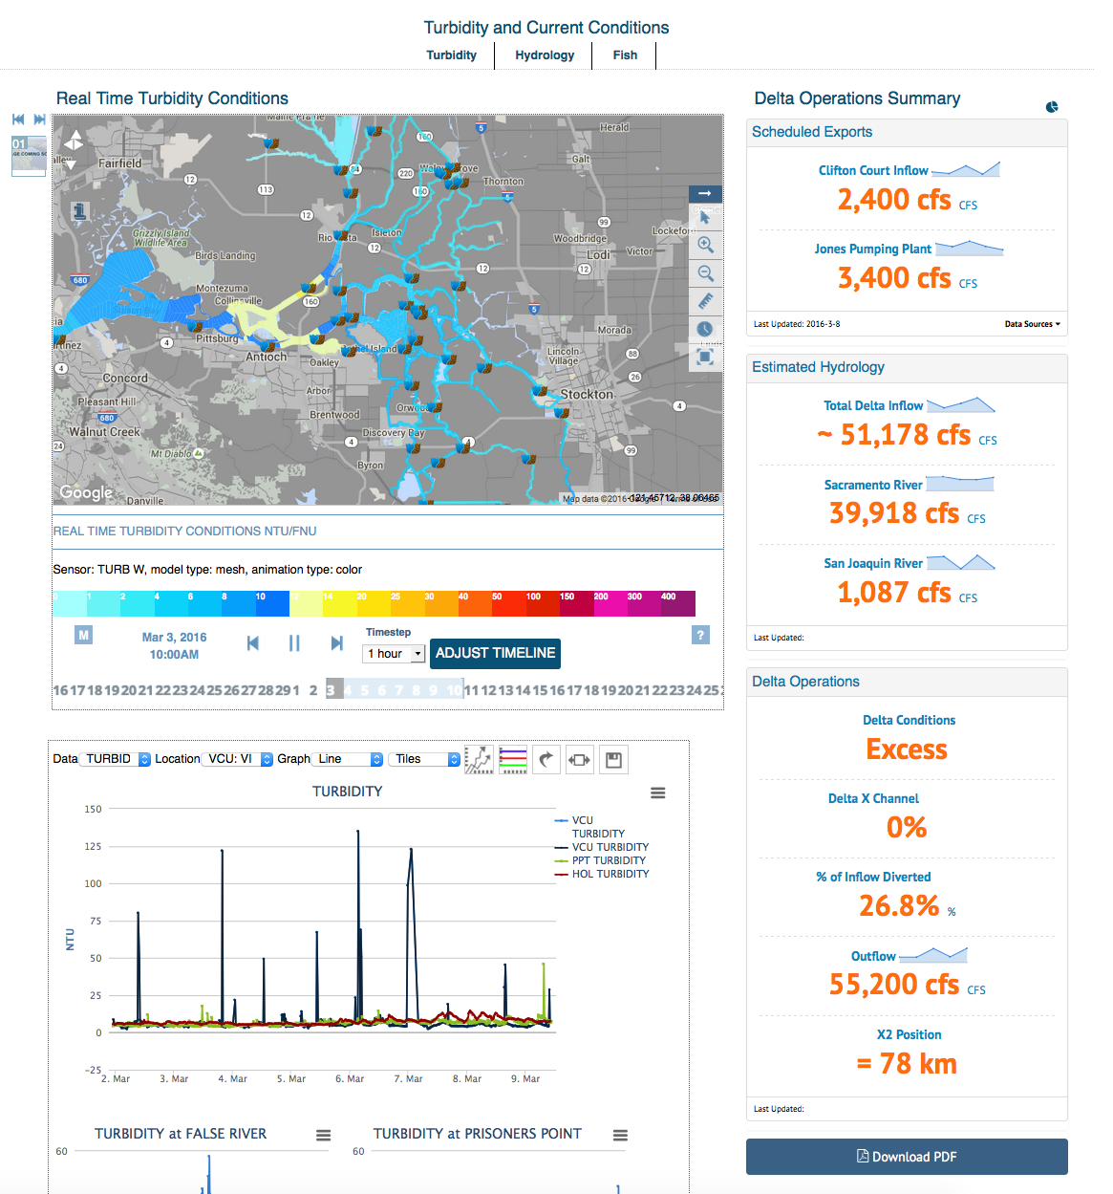
DCT Turbidity Conditions

Slide 6
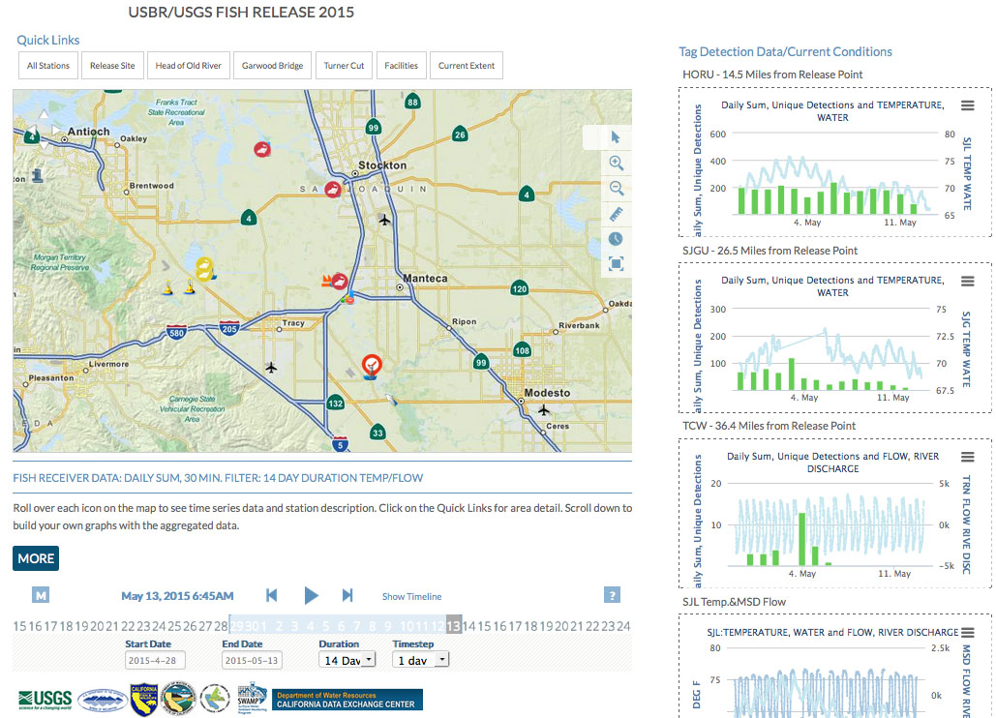
USGS/USBR Fish Tracking
Notes:
UNIQUE DETECTIONS AND DAILY SUM (using 30 minute unique detections filter and then sums)
Data dashboard templates and filters for our use.

Slide 7
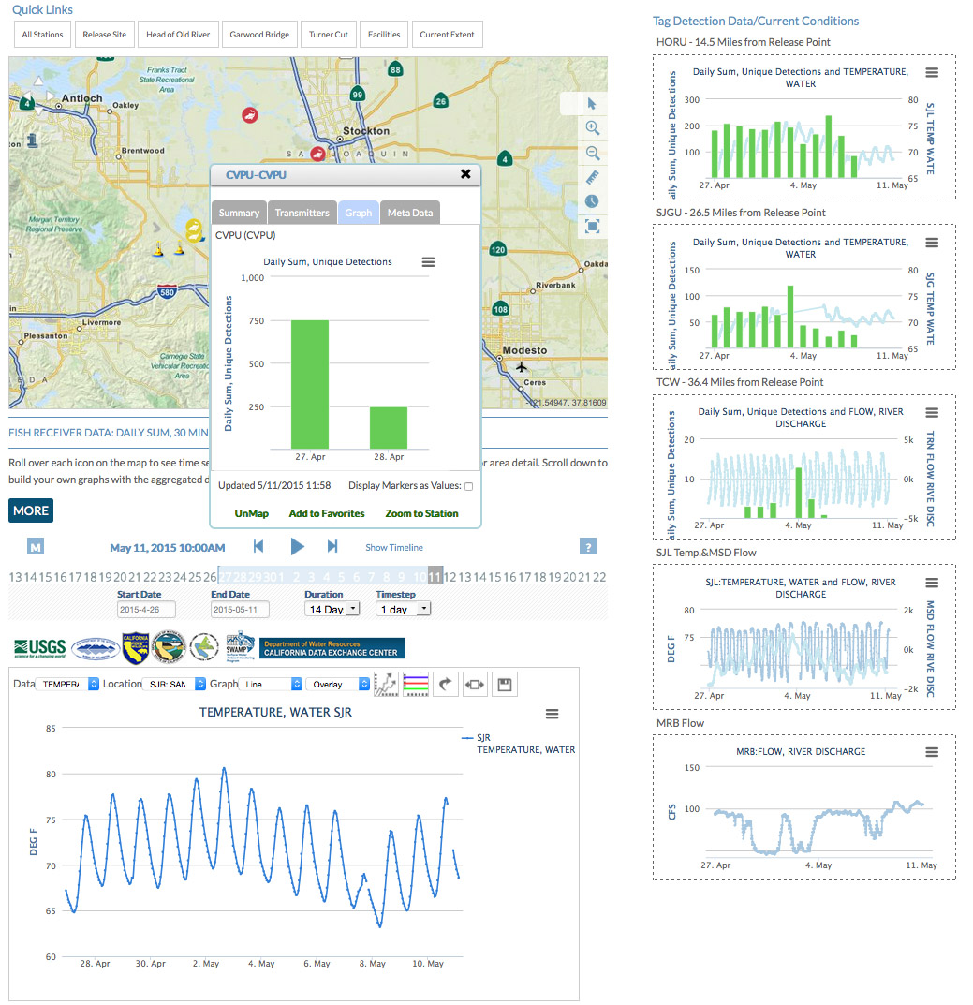
USGS/USBR Fish Tracking
Notes:
Clients include: Honeywell, USGS, DWR, MWD, History Channel,

