Slide 1
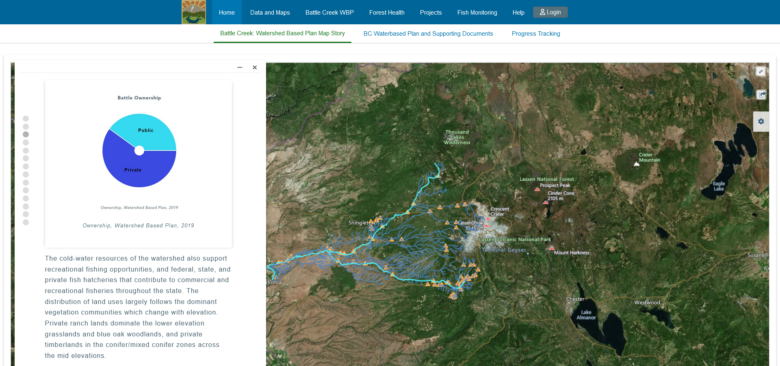
Version 1

Slide 2
Version 1.1

Slide 3
Version 1.2

Slide 4
Version 2

Slide 5
Version 2.1

Slide 6
Version 3

Slide 7
Version 3.1

Slide 8
Version 3 Pop-up

Slide 9
Version 4

Slide 10
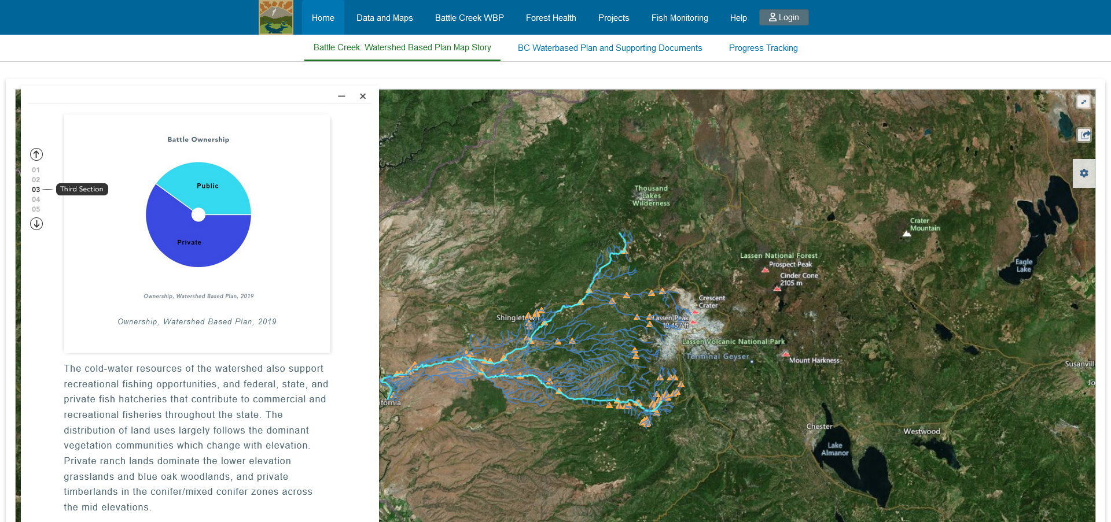
Version 5

Slide 11
Version 6

